Slide 1

SOLAR TRACKER-ALTITUDE AND AZIMUTH SOLAR ANGLES
ΝΕΚΤΑΡΙΟΣ ΚΟΥΡΑΚΗΣ
ΝΙΚΟΣ ΑΝΑΣΤΑΣΑΚΗΣ

Slide 2
Today's workshop has two objectives, to show that:
1) when turned at the right angle the photovoltaic panel has maximum energy efficiency
2) the recording of the angles formed by the sun in each place indirectly reveal the movement of the Earth around the Sun

Slide 3
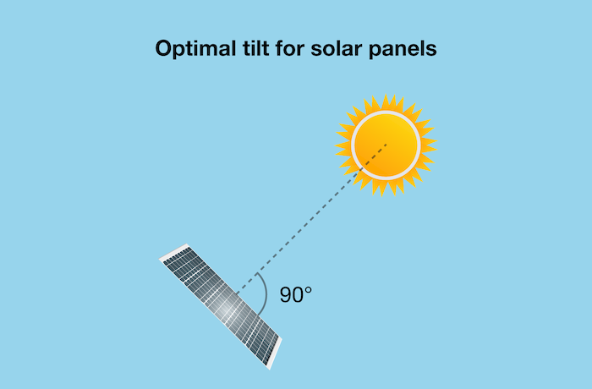

Slide 4
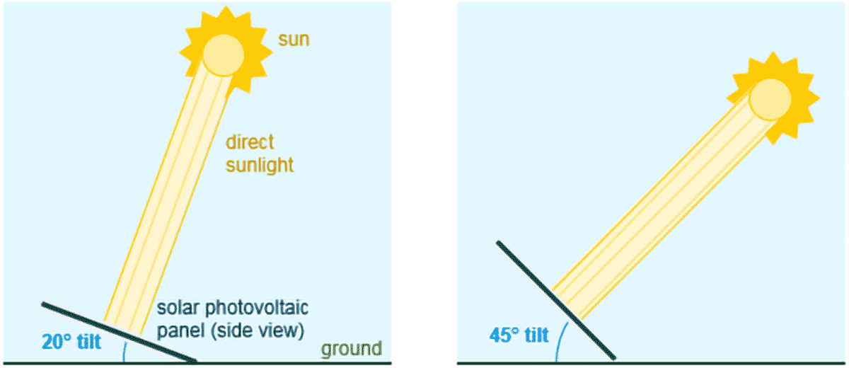

Slide 5
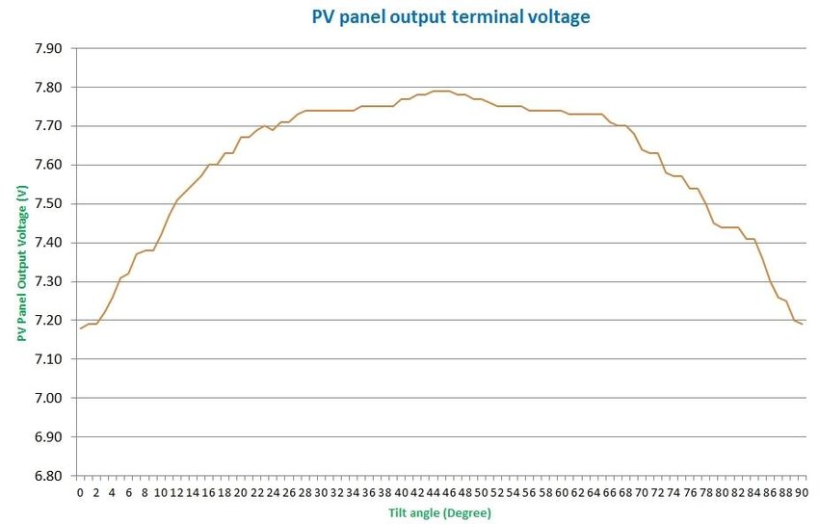

Slide 6
The solar altitude angle is the angle between the sun’s rays and a horizontal plane.
Sun height (altitude)
The altitude of the sun refers to the angle that the sun forms with the horizon of the Earth. Since it is an angle, it is measured in degrees.
The slope is 0 ° at sunrise and sunset and can reach 90 ° (zenith) at noon, in places close to the equator.
Due to the inclination of the earth's axis of rotation, the position of the sun in the equatorial sky at noon will deviate during the year by +/- 23.5 degrees from the absolute vertical (zenith).

Slide 7
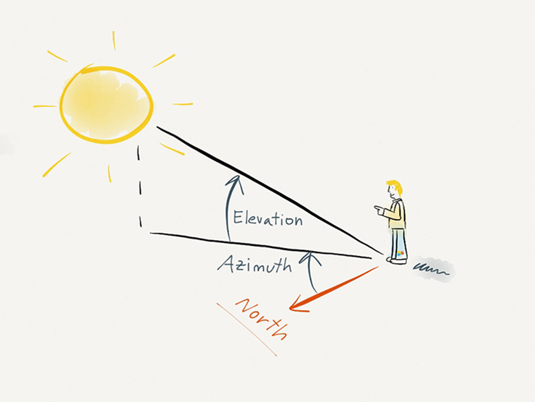

Slide 8
SUN -AZIMUTH
There are two ways of determining the azimuth.The first is from geographic north to east and the second from south to east +angle see the picture above , - angle to the other direction.

Slide 9
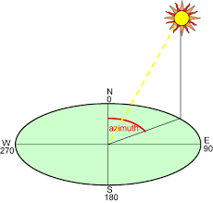

Slide 10
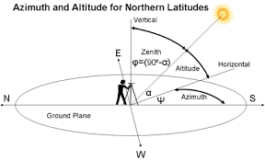

Slide 11
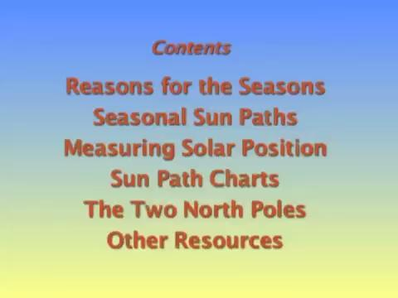

Slide 12
THANK YOU!

